Slide 1
Objective 1
•Start with a story from the problem of finding abnormal behavior in a CCTV (Firearm)..
•CNNs as a potential solution for image classification
•At this point, talk about CNN in abstract level - just as a black box machine that knows to classify images
•Describe the problem of the inference time of CNNs and the challenge to apply those to CCTV

Slide 2
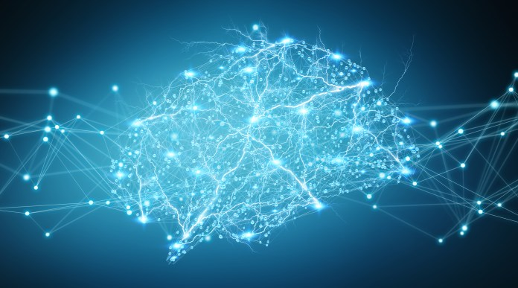
Accelerating Abnormal-Behavior Detection in Surveillance Video via Deep Neural Networks & Group Testing Methods

Slide 3
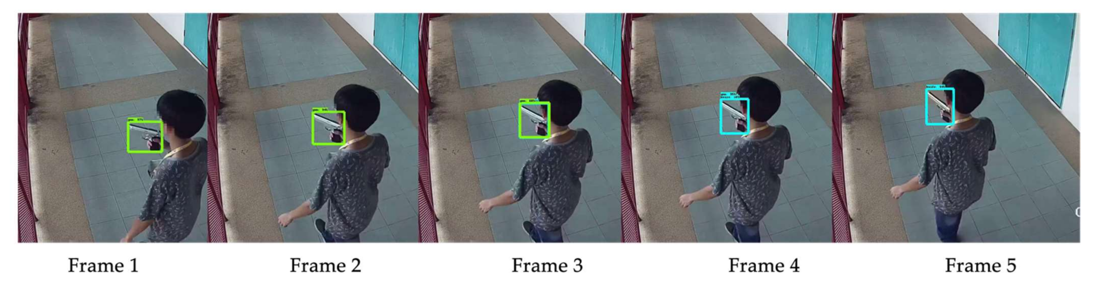
Motivation: The Firearm Detection Problem in CCTV
Challenge: Efficiently detecting abnormal behavior within vast surveillance footage.
Target: Detect and locate this in hours of footage.

Slide 4
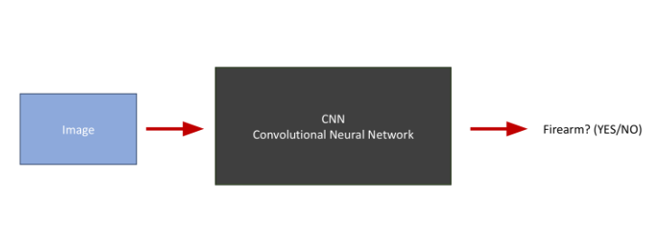
CNN: A High-level Overview
Suppose that we have the following machine (CNN)
Image -> CNN -> Classification Result

Slide 5
Motivation
Can we exploit this machine to look for firearm in CCTV (videos)?
CNN
Convolutional Neural Network
Image
Firearm? (YES/NO)
Sure…
CCTV
Frames

Slide 6
Naive Solution
CNN
Convolutional Neural Network
CCTV
Firearm?
(YES/NO)
Convert the video to frames
Check each frame one by one

Slide 7
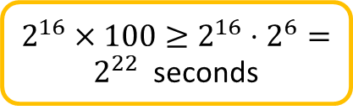
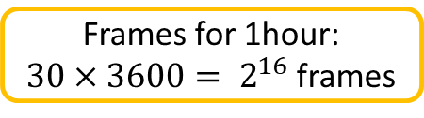
Problems with this solution
Suppose that we are asked to implement an automatic firearm detector to help police department to check CCTV’s from some street where a crime has occurred.
We want to find the exact time when some crime occurred within a range of one hour (e.g. 3:00am -4:00 am)
CNN
Convolutional Neural Network
CCTV
Firearm?
(YES/NO)
Standard CCTV frame rate is 30FPS
Inference GPU time: 100s for a single image
~85days

Slide 8
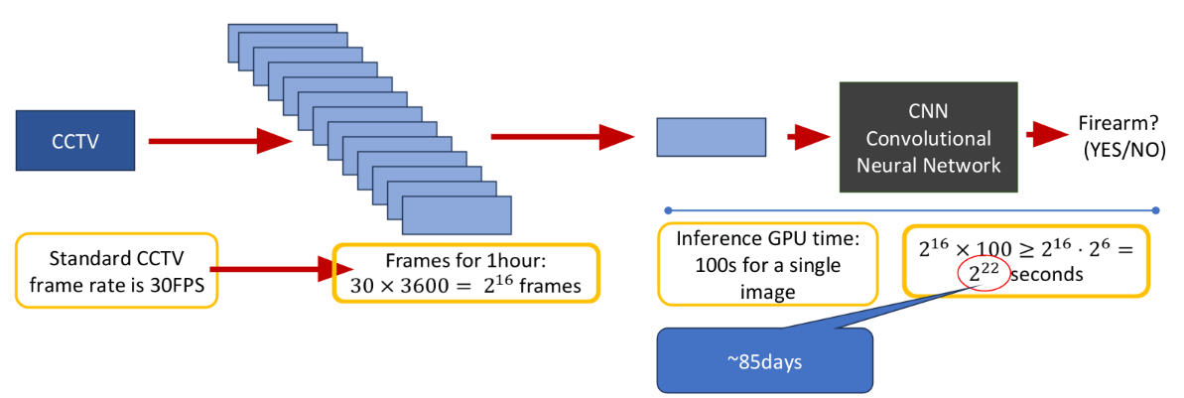
Inference Time Bottleneck
Issue: High inference time. Not suitable for real-time CCTV analysis.
Millions of frames = Significant delay.

Slide 9
Objective 2
•Talk about Group testing in very high level and try to describe:
•Why Group testing can be good direction for reducing inference time
•Explain why this is applicable to CCTV detection
•Too many good frames vs. very very few bad ones (these settings are ideal for group testing)

Slide 10
Three Possible Solutions
Choose a subset of the frames
Reduce inference time
Hardware
Optimize the structure of the CNN
Group Testing (We will mainly focus on this)

Slide 11
Solution #3: Group testing
Image
CNN
Convolutional Neural Network
Firearm? (YES/NO)
Due to the work of:
Weixin Liang, James Zou
Suppose that we can enhance the CNN such that:
Image
CNN
Convolutional Neural Network
Image
Yes: at least one frame includes firearm
No: Firearm clean
Image
Image
Image
Image

Slide 12
Solution #3: Group testing (cont.)
Image
CNN
Convolutional Neural Network
Image
Yes: at least one firearm frame
No: Firearm clean
Image
Image
Image
Image
How we choose the frames in each group, so we can actually determine the desired ones ????
Due to the work of: Bshouty & Haddad-Zaknoon
Do we really need to identify ALL the frames with firearm image?

Slide 13

What is Group Testing?
YES (positive)
NO (negative)
A group test is a subset of elements form the pile.
A group test result is positive
if there is at least one “red” (defective) item in this subset and negative otherwise.
Target: identify the set of defective items using minimum number of group tests

Slide 14
Group Testing works well for a small number of defective items; usually, the abnormal frames only account for a small portion of the whole frames.
Abnormal frames are consecutive, so it is enough to find a single frame that captured the event.

Slide 15
Let’s take a deeper look…
Assume that we have reduced the number frames.
By choosing frames uniformly at random or ..
Making some kind of average on images (for example pixel based average)
We order the chosen frames according to their original timeline.
The blue frames are ones that capture the abnormal event.
They are consecutive, because we ordered the chosen frame according to their time.
We need to determine this time frame within the video
3:00
It is enough to find a single frame that captured the event
4:00

Slide 16
What is Group Testing Problem?
•Def: Given a set S of n items, among which d are defective, the objective is to identify the defective items by performing the minimum number of tests.
•Using GT(like designing some adaptive or non-adaptive algorithms) to solving such problems

Slide 17
Adaptive algorithm
•A new test is chosen according to the results of previous tests.
•This algorithm proceeds according a “binary tree like” shape. Where each node signifies a test and the leaves signify the possible outputs.

Slide 18
Non-Adaptive Algorithms
•Tests are chosen in advance and performed in ONE single parallel step.
•Upon getting the result vector, the algorithm decodes the outcome and decides on its output. The decoding process requires NO further testing.

Slide 19
Example problem: The poisoned bottle.
•The king and the wine riddle:
•The King of a small country invites 1000 senators to his annual party.
•Each senator brings the King a bottle of wine.
•The queen discovers that one of the senators is trying to assassinate the King by giving him a bottle of poisoned wine
•Unfortunately, they do not know which bottle of wine is poisoned, and the poison is completely indiscernible.
•The King has 10 prisoners he plans to execute. He decides to use them as taste testers to determine which bottle of wine contains the poison.

Slide 20
Adaptive algorithm for poisoned bottles.
•Define a single group test
•Perform the group test
•Upon getting the result, decided on your next test

Slide 21
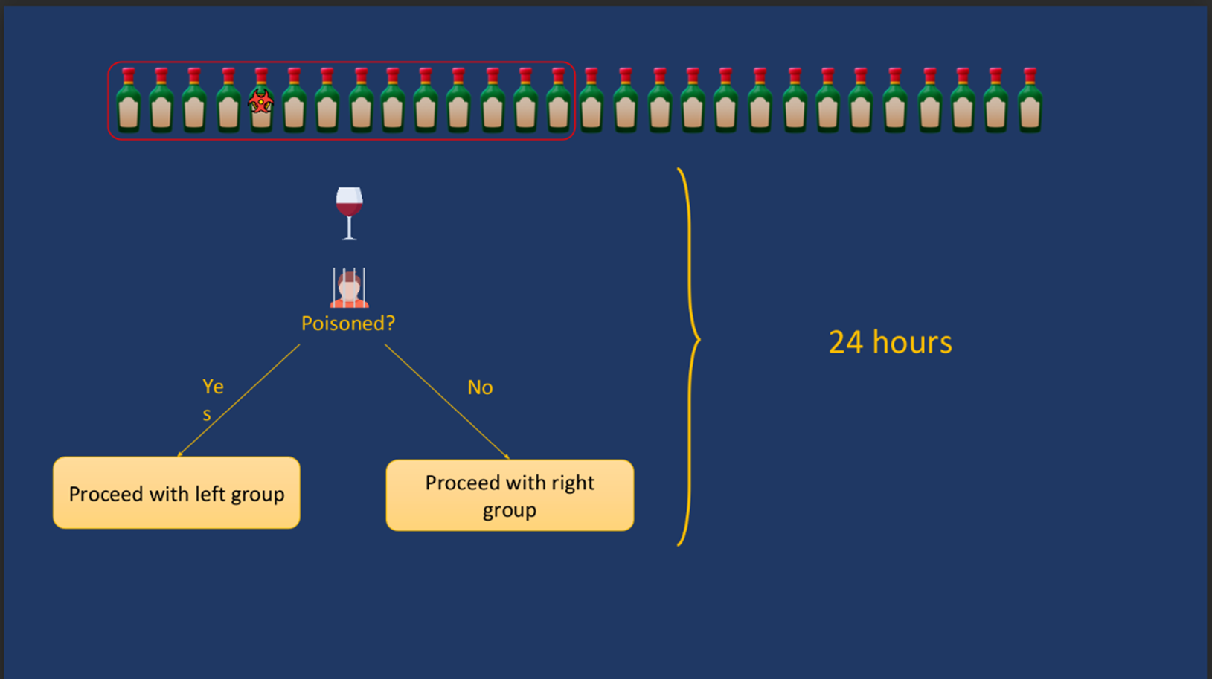

Slide 22
Non-Adaptive algorithm for poisoned bottles.
•Define all group tests in advance
•Perform all the group tests in parallel
•Upon getting the results, decode the result without any further testing

Slide 23
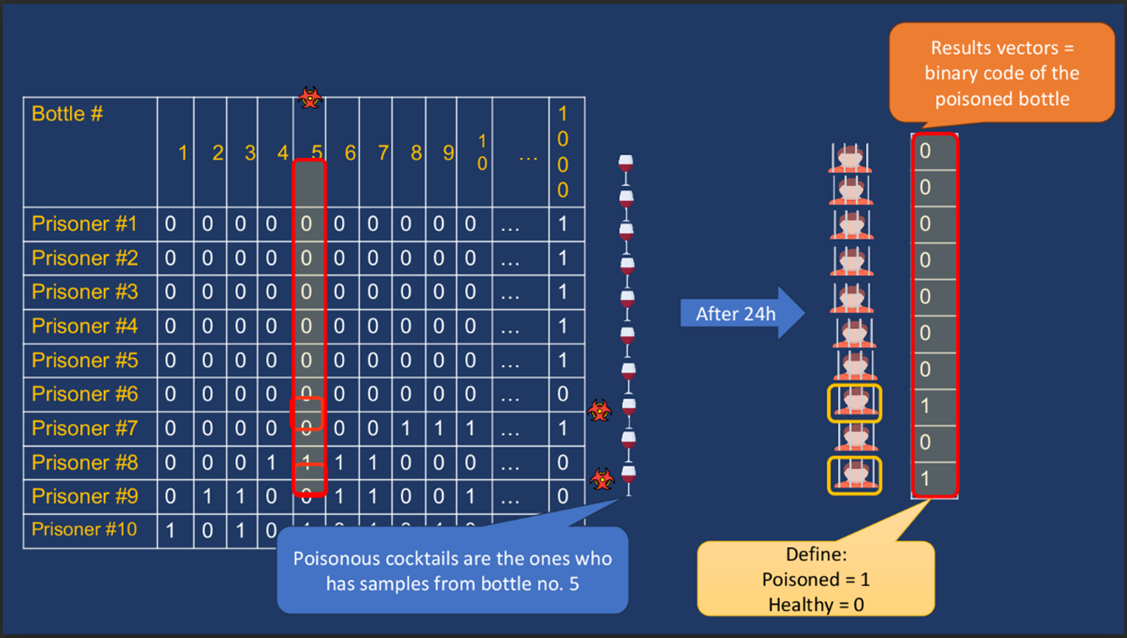

Slide 24
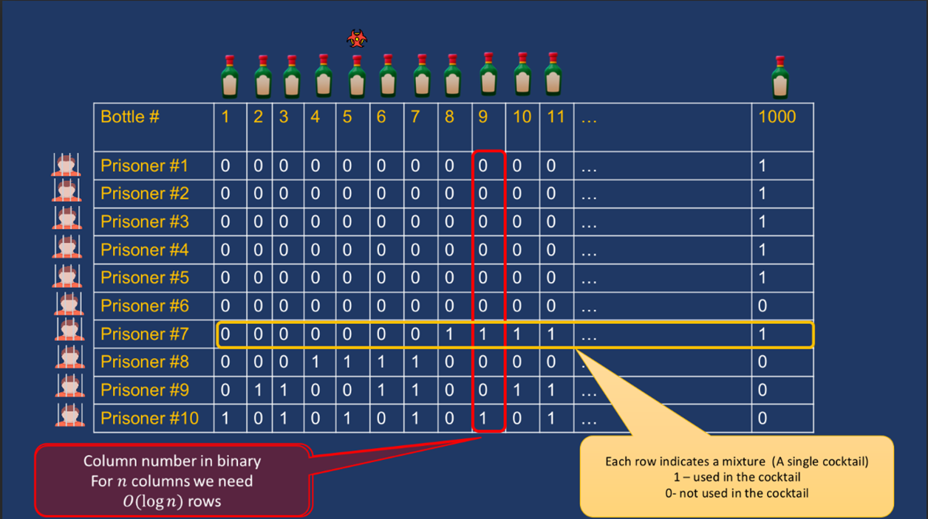

Slide 25
Why GT problem is important via its vast applications
•Example: The COVID-19 scenario
•Suppose we have n=4000 soldiers in a specific unit that we want to text for COVID-19 virus Suppose that only d=1 are infected
•Our target is identify the 1 patient, to give him proper treatment, without taking the risk of the virus spreading among the whole unit.

Slide 26
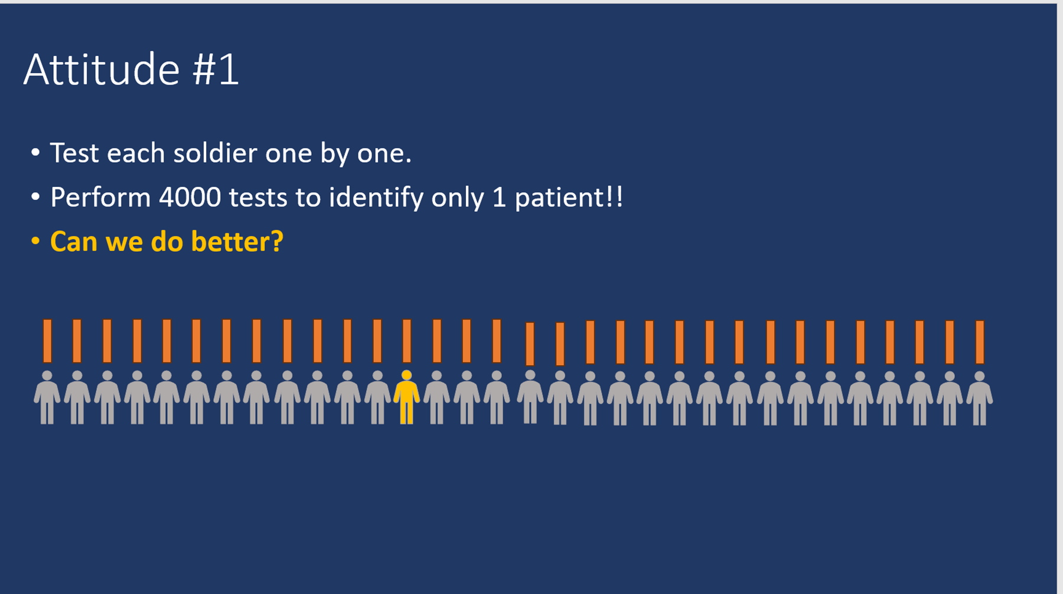

Slide 27
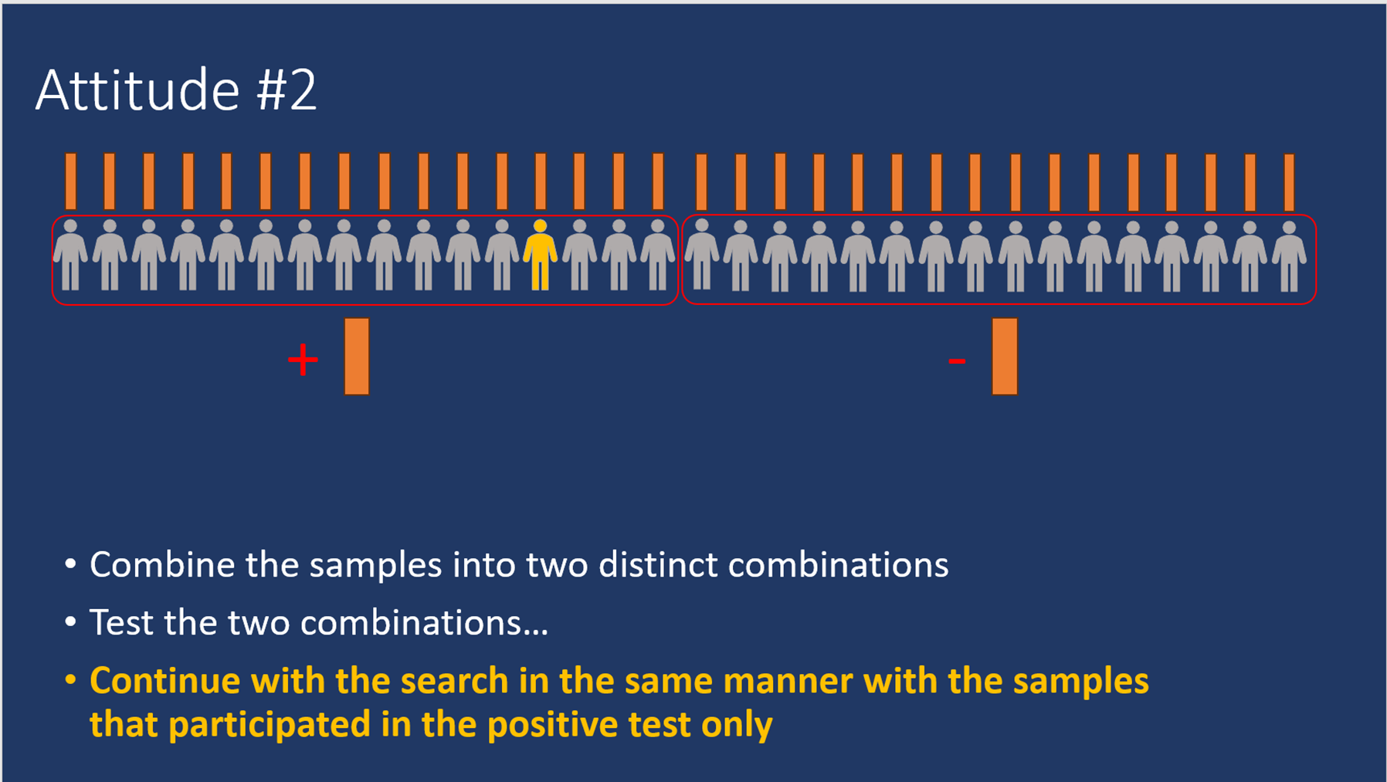

Slide 28
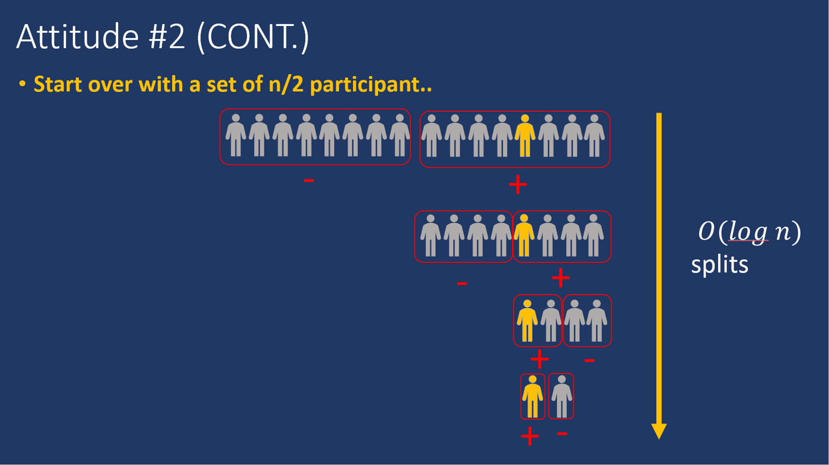

Slide 29
Group testing 2 – non-adaptive algorithms
•We are trying to optimize the number of tests we do
•Tests = Cocktails in the poisoned bottle problem
•Test = running an image via the CNN in the context of image classification.
•Why we are interested in randomized non-adaptive algorithms
•Non-adaptive: tests take time and it will be better to do them in parallel
•Randomized: the bounds on the number of tests for deterministic vs. randomized

Slide 30
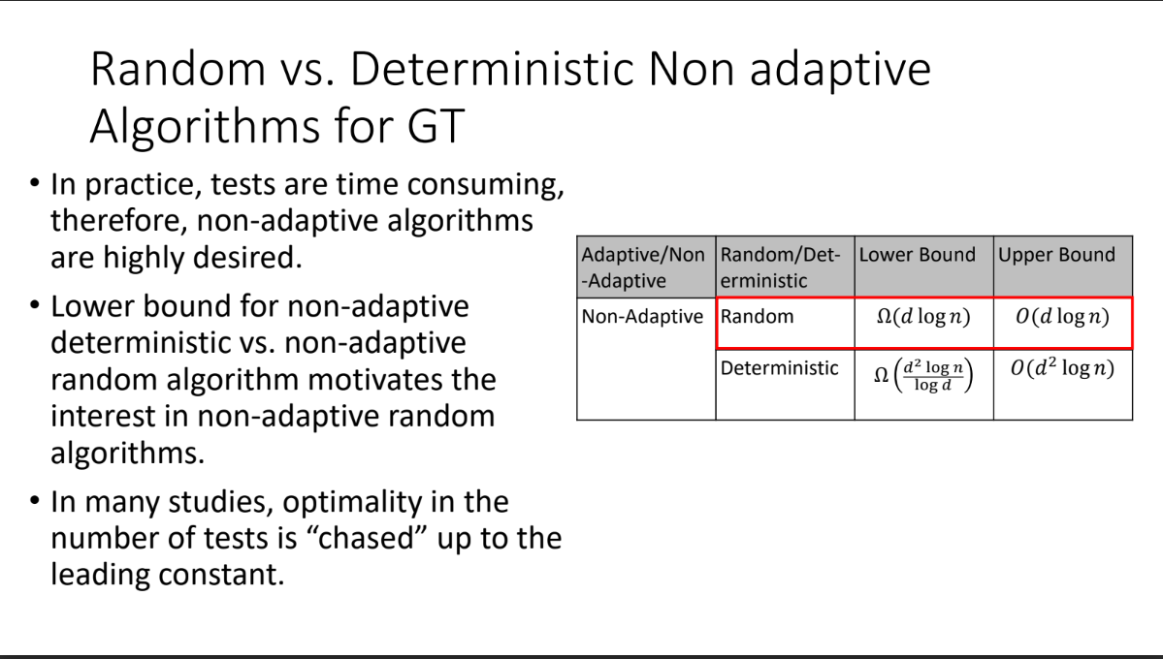

Slide 31
test matrix (an example for matrix from poisoned bottle problem)

Slide 32
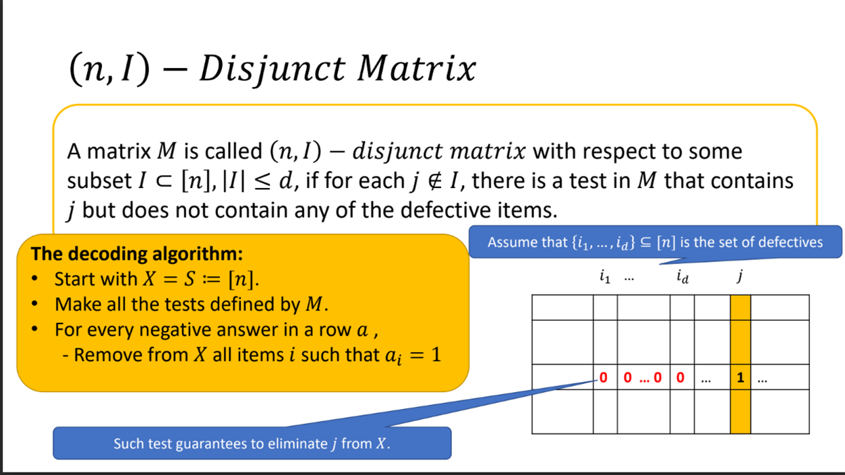

Slide 33
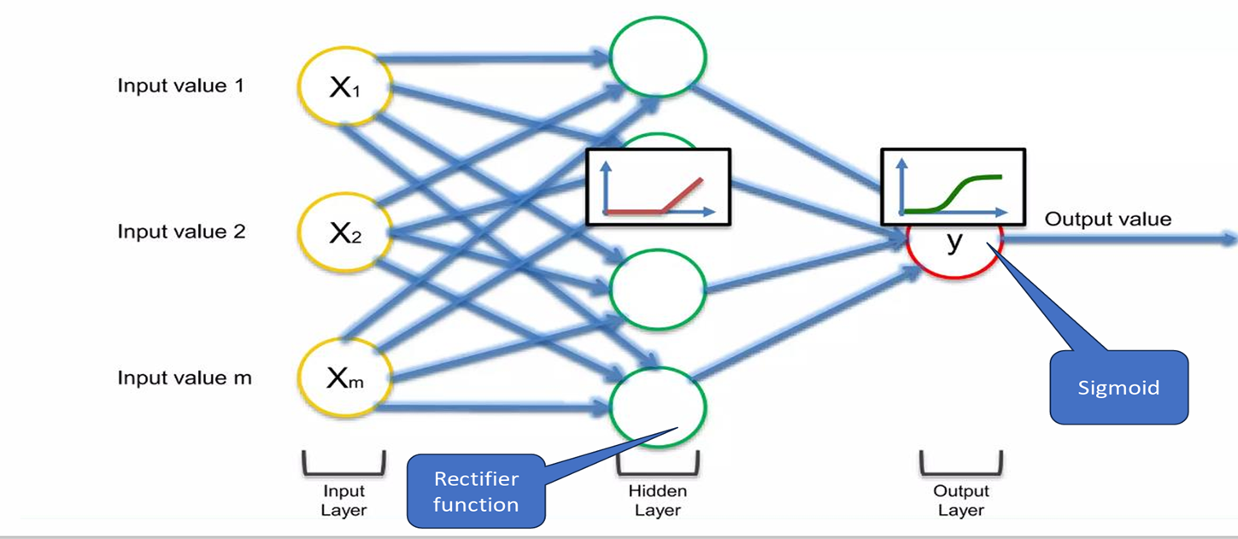
The structure of Neural Network

Slide 34
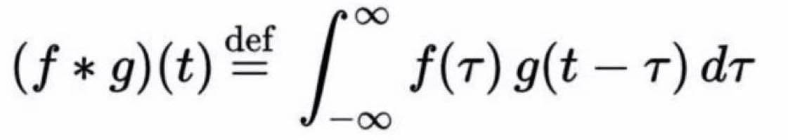
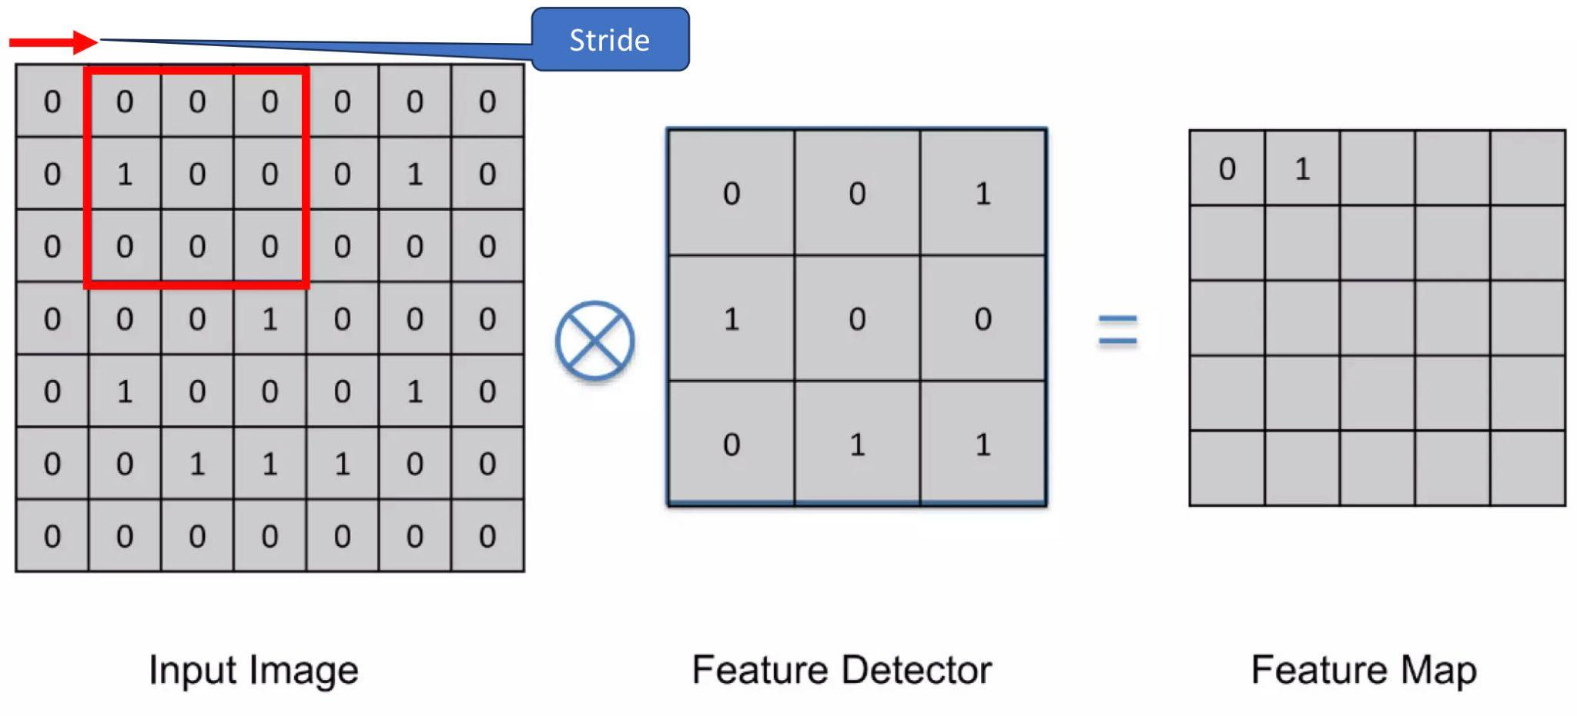
Convolution:
In math, convolution function:
In CNNs:

Slide 35
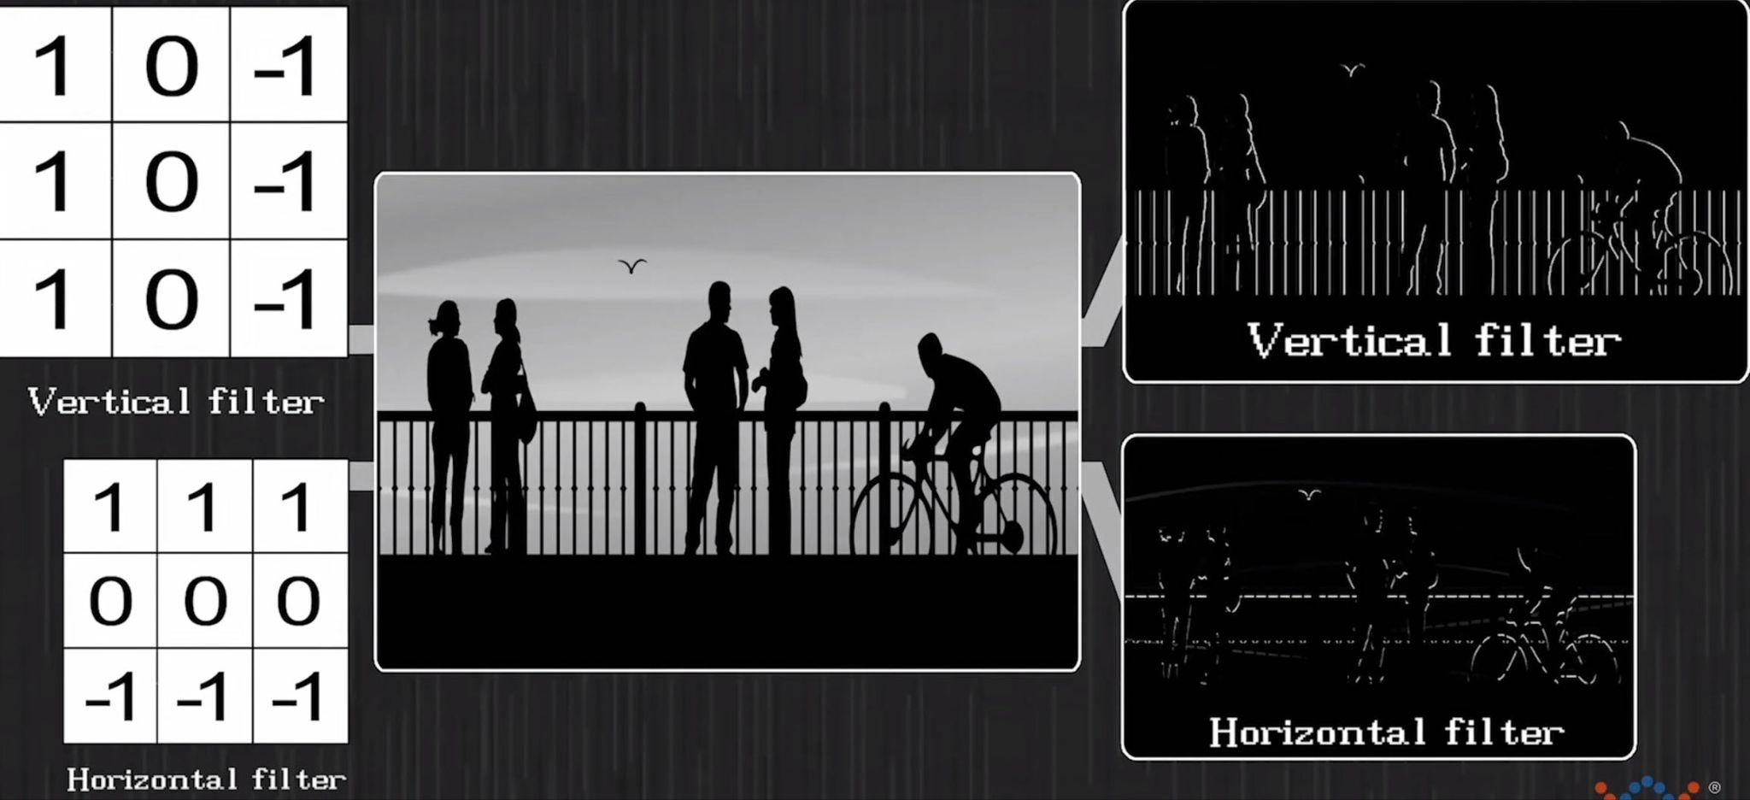
Example:

Slide 36
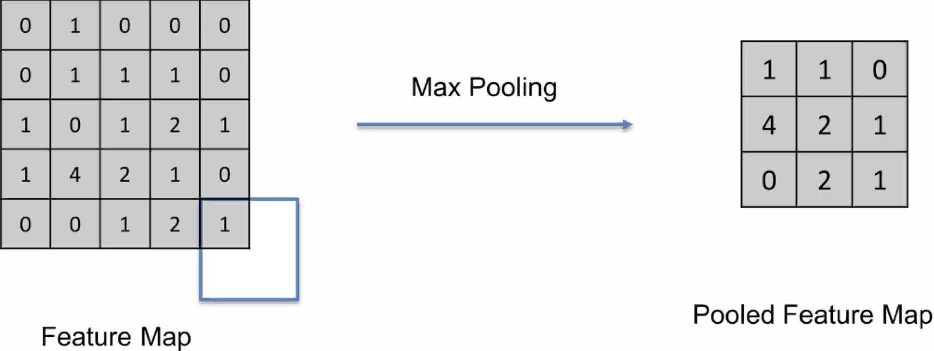
Pooling:

Slide 37
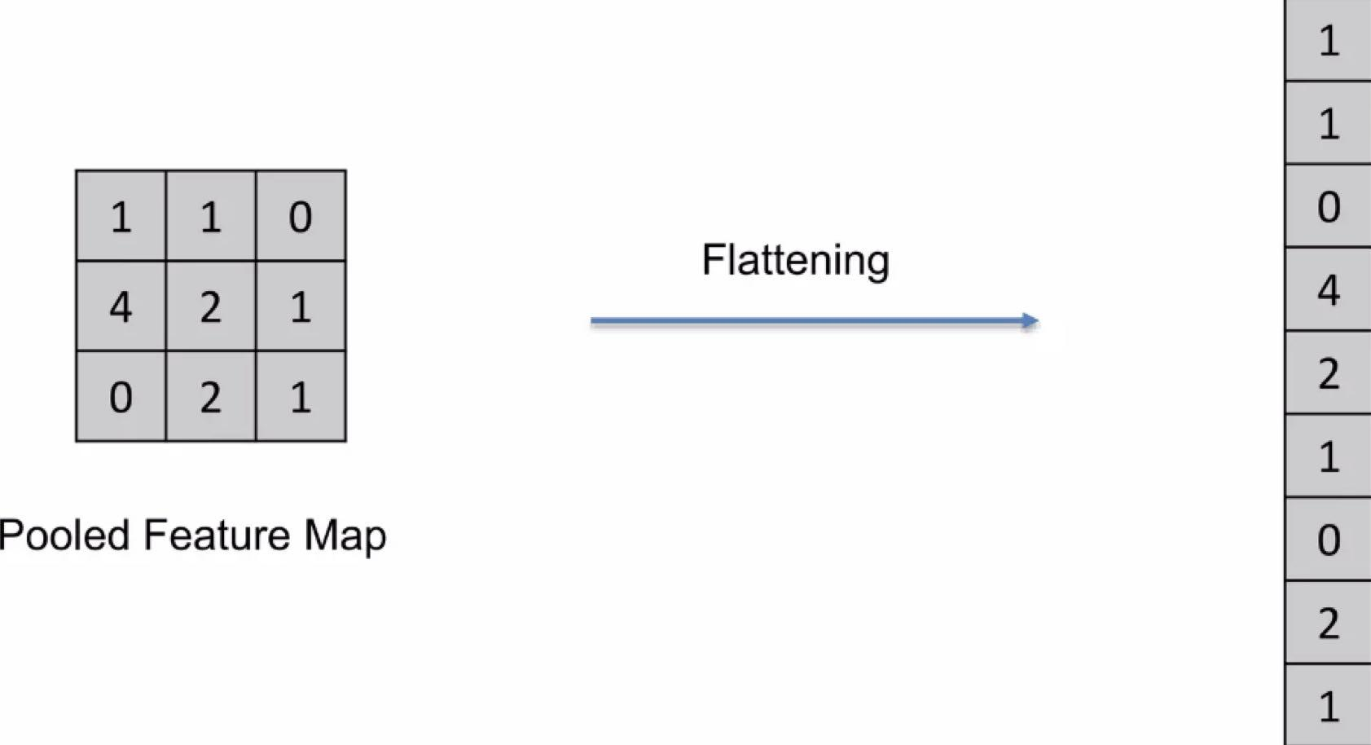
Flatening:

Slide 38
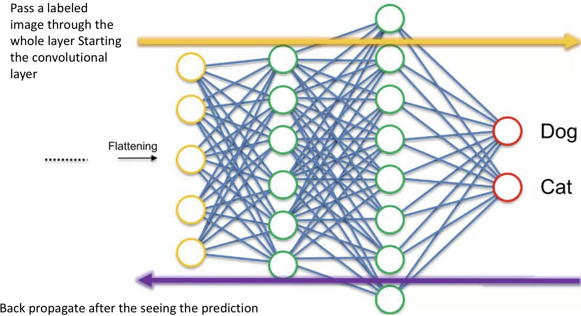
Fully connected NN:

Slide 39
GT and CNN marriage

Slide 42
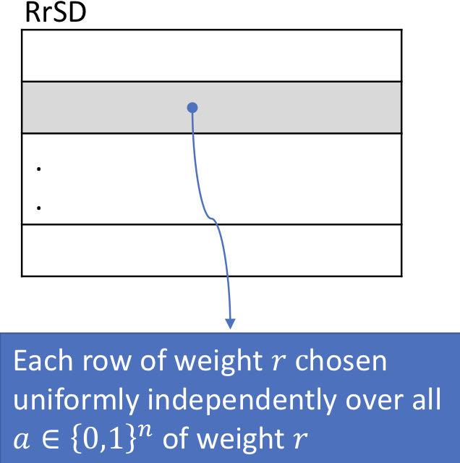
Non-adaptive algorithm:RrSD model
*the Random R-Size Design
*Create a random binary m×n matrix
*Each row is of weight r
*Each row is chosen uniformly randomly over
all a∊{0,1}^m of weight s

Slide 43
Methods
Programming language: python
Version control system Git and GitHub
Training Server:
96 Intel(R) Xeon(R) Gold 6336Y CPU @ 2.40GHz 503GB RAM 8 x NVIDIA A40 – 49GB
Traning Set: Imagenet

Slide 44
Methods : ImageNet dataset
•ImageNet is a dataset of over 14 million hand-annotated images. It has been one of the most influential datasets in the field of deep learning, particularly for tasks related to computer vision.
•The dataset is organized according to the WordNet hierarchy, which groups similar concepts together. ImageNet has over 20,000 categories, and for each category, there are typically several hundred images.
•Key contributors to the project include:
•Dr. Fei-Fei Li: The principal investigator and driving force behind ImageNet.
•Jia Deng, Wei Dong, Li-Jia Li, Kai Li, and Li Fei-Fei: Co-authors of the 2009 paper "ImageNet: A Large-Scale Hierarchical Image Database," which introduced ImageNet to the computer vision community.

Slide 45
Results
•We used the open source code of the paper authors.
•We added the Rrsd model by modifying the variables(used in Rrsd model like p and delta)in the original code
•Testing

